Slide 1

JavaScript Advanced
By
BJIT Academy
Image Placeholder

Slide 2
JavaScript Callbacks
A callback is a function passed as an argument to another function.
Old method Example
Callback Example
function myDisplayer(some) {
document.getElementById("demo").innerHTML = some;
}
function myCalculator(num1, num2) {
let sum = num1 + num2;
myDisplayer(sum);
}
myCalculator(5, 5);
function myDisplayer(some) {
document.getElementById("demo").innerHTML = some;
}
function myCalculator(num1, num2, myCallback) {
let sum = num1 + num2;
myCallback(sum);
}
myCalculator(5, 5, myDisplayer);
Note
When you pass a function as an argument, remember not to use parenthesis.
Right: myCalculator(5, 5, myDisplayer);
Wrong: myCalculator(5, 5, myDisplayer());

Slide 3
JavaScript map()
Example:
The map() method creates a new array populated with the results of calling a provided function on every element in the calling array.
const array1 = [1, 4, 9, 16];
// Pass a function to map
const map1 = array1.map((x) => x * 2);
console.log(map1);
// Expected output: Array [2, 8, 18, 32]

Slide 4
Javascript filter()
The filter() method creates a shallow copy of a portion of a given array, filtered down to just the elements from the given array that pass the test implemented by the provided function.
Demo:
const words = ['spray', 'limit', 'elite', 'exuberant', 'destruction', 'present'];
const result = words.filter((word) => word.length > 6);
console.log(result);
// Expected output: Array ["exuberant", "destruction", "present"]

Slide 5
Javascript reduce()
The reduce() method executes a user-supplied "reducer" callback function on each element of the array, in order, passing in the return value from the calculation on the preceding element.
The final result of running the reducer across all elements of the array is a single value.
Example:
const numbers = [175, 50, 25];
document.getElementById("demo").innerHTML = numbers.reduce(myFunc);
function myFunc(total, num) {
return total - num;
}

Slide 6
Synchronous Code
When we write a program in JavaScript, it executes line by line.
When a line is completely executed, then and then only does the code move forward to execute the next line.
Example:
let greet_one = "Hello"
let greet_two = "World!!!"
console.log(greet_one)
for(let i=0;i<1000000000;i++){
}
console.log(greet_two);

Slide 7
Asynchronous Code
Example:
With asynchronous code, multiple tasks can execute at the same time while tasks in the background finish. This is what we call non-blocking code. The execution of other code won't stop while an asynchronous task finishes its work.
let greet_one = "Hello"
let greet_two = "World!!!"
console.log(greet_one)
setTimeout(function(){
console.log("Asynchronous");
}, 10000)
console.log(greet_two);

Slide 8
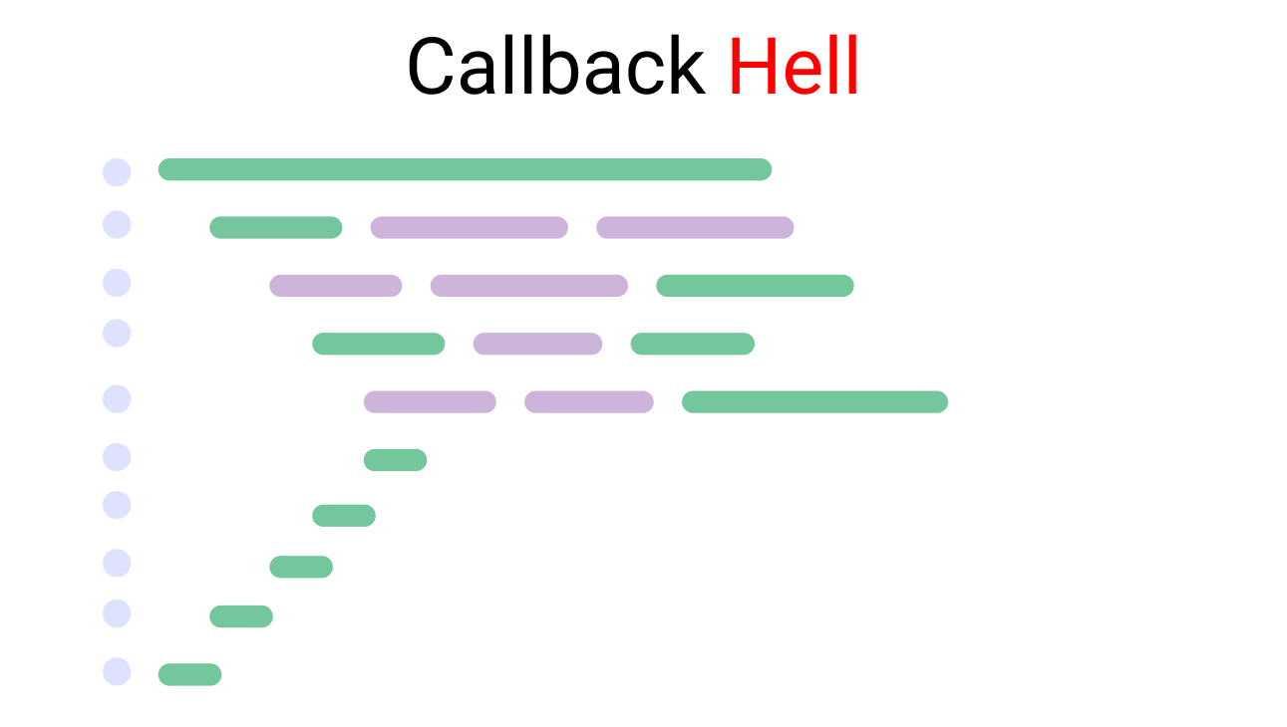
Callback hell
Example:
let production = () =>{
setTimeout(()=>{
console.log("production has started")
setTimeout(()=>{
console.log("The fruit has been chopped")
setTimeout(()=>{
console.log(`${stocks.liquid[0]} and ${stocks.liquid[1]} Added`)
setTimeout(()=>{
console.log("start the machine")
setTimeout(()=>{
console.log(`Ice cream placed on ${stocks.holder[1]}`)
setTimeout(()=>{
console.log(`${stocks.toppings[0]} as toppings`)
setTimeout(()=>{
console.log("serve Ice cream")
},2000)
},3000)
},2000)
},1000)
},1000)
},2000)
},0000)
};
Illustration of Callback hell

Slide 9
JavaScript Promise
A Promise is a special JavaScript object. It produces a value after an asynchronous (aka, async) operation completes successfully, or an error if it does not complete successfully due to time out, network error, and so on.
You can create a promise using the promise constructor like this:
let promise = new Promise(function(resolve, reject) {
// Make an asynchronous call and either resolve or reject
});

Slide 10
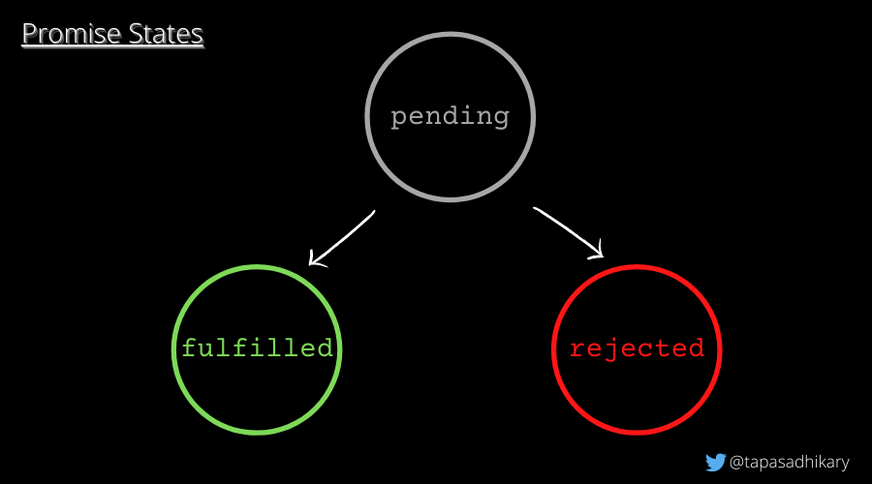
JavaScript Promise
A promise object has the following internal properties:
state – This property can have the following values:
pending: Initially when the executor function starts the execution.
fulfilled: When the promise is resolved.
rejected: When the promise is rejected.
2. result – This property can have the following values:
undefined: Initially when the state value is pending.
value: When resolve(value) is called.
error: When reject(error) is called.

Slide 11
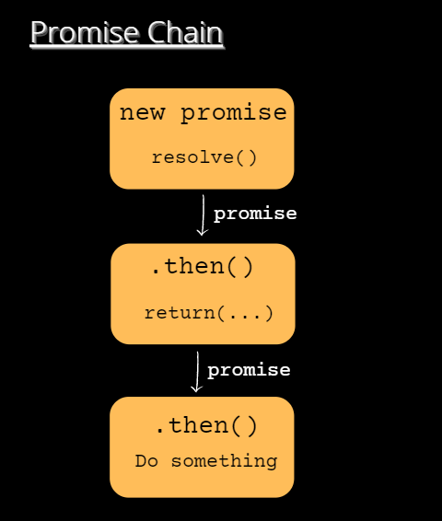
Promise Chain
The promise.then() call always returns a promise. This promise will have the state as pending and result as undefined. It allows us to call the next .then method on the new promise.

Slide 12
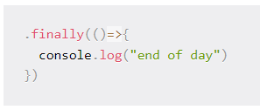
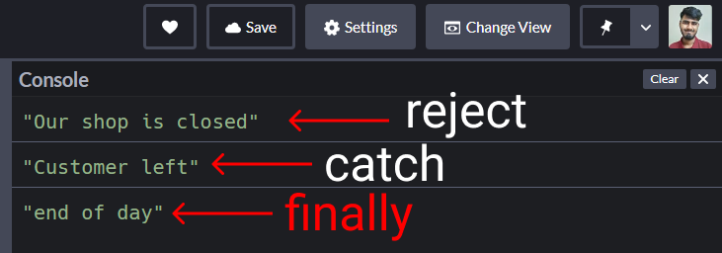
JavaScript Promise
The .finally() handler
If you're curious to test this, come at very bottom and write this code:
There's something called the finally handler which works regardless of whether our promise was resolved or rejected.
The result:
For example: whether we serve no customers or 100 customers, our shop will close at the end of the day

Slide 13
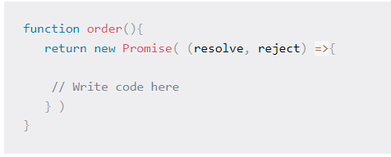
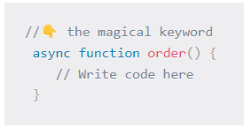
Async/Await in JavaScript
Before async/await, to make a promise we wrote this:
Now using async/await, we write one like this:

Slide 14
Prototype in JavaScript
javaScript is a dynamic language. You can attach new properties to an object at any time as shown below.
Example:
function Student() {
this.name = 'John';
this.gender = 'Male';
}
var studObj1 = new Student();
studObj1.age = 15;
alert(studObj1.age); // 15
var studObj2 = new Student();
alert(studObj2.age); // undefined

Slide 15
Thank You
Image Placeholder

